Slide 1
Regulating GSCs under MICAR
Prof. Dr. Dirk A. Zetzsche, LL.M. ADA Chair in Financial Law (inclusive finance)
University of Luxembourg

Slide 2
Regulating GSC
The Issue
International Perspective
The Draft MICAR
Three Comments
Conclusion & Take Away

Slide 3

I. The Issue
From Intermediary- to Platform-based Payments
Libra as Catalyst
Technology
Funding
Size in terms of customers
About Gaps and Uncertain Scope of Regulation
Regulating Libra
www.ssrn.com/abstract =3414401

Slide 4
Libra Set-up
Custodian 1
delivery
Authorized securities exchange
Buy/Sell
of Libra
Buy/Sell
of Libra
Custodian 2
Authorized securities exchange
delivery
Libra Holder
Crypto-Exchanges authorized by Libra Association (CEX 1 - N)
Libra Association
Pool of securities / bank deposits
Custodian 3
delivery
Authorized securities exchange
Digital Wallet
Custodian 4
Authorized securities exchange
delivery
Libra Reserve
Custodian N
Authorized securities exchange
delivery
Asset Manager / Investment Advisor
buy/sell orders

Slide 5
I. The Issue
From Intermediary- to Platform-based Payments
Libra as Catalyst
Technology
Funding
Size in terms of customers
About Gaps and Uncertain Scope of Regulation
Regulatory Objective
Client Protection?
Systemic Risk?
Market Integrity?

Slide 6
II. International Perspective
GSC
Market Integrity
Financial Stability
Market Efficiency?
Investor / Client Protection
IOSCO Global Stablecoin Initiatives (March 2020)
FSB Consultative Document on Global Stablecoins (April 2020): Financial Stability
FATF Report to G20 on So-called Stablecoins (July 2020): Market Integrity

Slide 7
III. The Draft MICAR
EU Digital Finance Strategy
A Primer to MiCAR – with a focus on GSCs
Supervision of GSC under MiCAR

Slide 8
EU DIGITAL FINANCE STRATEGY of 24 Sept 2020
Plus
proposal for digital operational resilience
Plus
Proposal to clarify or amend certain related EU financial services rules
EU Com: Option 1 – bespoke legislative regime aimed at addressing the risks posed by ‘stablecoins’ and ‘global stablecoins’

Slide 9
B. MiCAR’s ToC
Title I: Subject Matter, Scope and Definitions
Title II: Crypto-Assets, other than asset-referenced tokens or e-money tokens
Title III: Asset-referenced Tokens
Title IV: Electronic Money Tokens
Title V: Autorisation and operating conditions for Crypto-Asset Service providers
Title VI: Prevention of Market Abuse involving crypto-assets
Title VII: Competent Authorities, the EBA and the ESMA
Title VIII: Delegate Acts and Implementing Acts
Title IX: Transitional and Final Rules

Slide 10
Definitions
Crypto-Asset
Asset-referenced Token (III)
E-Money Token (IV)
Other (II)

Slide 11
Definitions
GSC
crypto-asset that purports to maintain a stable value by referring to the value of several fiat currencies that are legal tender, one or several commodities or one or several crypto-assets, or a combination of such assets;
Asset-referenced Token (ART)
Crypto Asset
‘crypto-asset’ means a digital representation of value or rights which may be transferred and stored electronically, using distributed ledger technology or similar technology;
crypto-asset the main purpose of which is to be used as a means of exchange and that purports to maintain a stable value by referring to the value of a fiat currency that is legal tender;
E-money Token (EMT)

Slide 12
Definitions
Security Tokens?
Asset-referenced tokens
E-money tokens
Other Crypto-assets
‘Global Stable Coin’
Payment tokens – 1:1: ‘Stable Coins’
Usage tokens
EU Securities Law:
ProspectusR, MiFID, Transparency Directive

Slide 13
Title II: Crypto-Assets, other than asset-referenced tokens or e-money tokens
Article 4 Offers of crypto-assets (…) to the public, and admission of such crypto-assets to trading on a trading platform for crypto-assets
Article 5 Content and form of the crypto-asset white paper
Article 6 Marketing communications
Article 7 Notification of the crypto-asset white paper, and, where applicable, of the marketing communications
Article 8 Publication of the crypto-asset white paper, and, where applicable, of the marketing communications
Article 9 Offers to the public of crypto-assets (…) that are limited in time
Article 10 Permission to offer crypto-assets (…) to the public or to seek admission for trading such crypto-assets on a trading platform for crypto-assets
Article 11 Modification of published crypto-asset white papers and, where applicable, published marketing communications after their publication
Article 12 Right of withdrawal
Article 13 Obligations of issuers of crypto-assets (…)
Article 14 Liability of issuers of crypto-assets (…) for the information given in a crypto-asset white paper
‘Special Prospectus Regulation’

Slide 14
Title III: Asset-referenced Tokens (GSC)
Chapter 1
Authorisation to offer asset-referenced tokens to the public and to seek their admission to trading on a trading platform for crypto-assets
Article 15 Authorisation
Article 16 Application for authorization
Article 17 Content and form of the crypto-asset white paper for asset-referenced tokens
Article 18 Assessment of the application for authorization
Article 19 Grant or refusal of the authorization
Article 20 Withdrawal of the authorization
Article 21 Modification of published crypto-asset white papers for asset-referenced tokens
Article 22 Liability of issuers of asset-referenced tokens for the information given in a crypto-asset white paper
«issuance» of ART Regulated activity, subject to licensing
Legal entity to be located in EU

Slide 15
Title III: Asset-referenced Tokens
Chapter 2
Obligations of all issuers of asset-referenced tokens
Article 23 Obligation to act honestly, fairly and professionally in the best interest of the holders of asset-referenced tokens
Article 24 Publication of the crypto-asset white paper, and, where applicable, of the marketing communications
Article 25 Marketing communications
Article 26 Ongoing information to holders of asset-referenced tokens
Article 27 Complaint handling procedure
Article 28 Prevention, identification, management and disclosure of conflicts of interest
Article 29 Information to competent authorities
Article 30 Governance arrangements
Article 31 Own funds requirements
Operating Conditions
350 TEUR plus 2% of Reserve Assets in Tier 1 Assets (‘Equity)
Notes:
Has exceeded EUR 1250 billions cash value => 25 Billion Reserve Assets

Slide 16
Title III: Asset-referenced Tokens
CHAPTER 3
RESERVE OF ASSETS
Article 32 Obligation to have reserve assets, and composition and management of such reserve of assets
Article 33 Custody of reserve assets
Article 34 Investment of the reserve assets
Article 35 Rights on issuers of asset-referenced tokens or on the reserve assets
Article 36 Prohibition of interest
Reserve Management: Minimal market and credit risk (‘state funding’
Asset Segregation

Slide 17
Title III: Asset-referenced Tokens
CLEAR POLICY on Asset Holders rights (Art. 35 I)
Including
(a) Conditions, including thresholds, periods and timeframes, to exercise those rights;
(b) Redemption mechanisms and procedures, incl. under stress, insolvency etc;
(c) Valuation of the asset-referenced tokens and of the reserve assets
(d) Settlement conditions;
(e) Fees.
Where rights are not granted to all token holders : Liquidity Management, but
=> Statutory redemption right if ‘market value of asset-referenced tokens varies significantly from the value of the reference assets or the reserve assets’ => Semi-open ended; requires designated market maker
No position on holders’ rights: « open » or « closed end »

Slide 18
Crypto-Asset Services a Authorized Activities
TITLE V: Authorisation and operating conditions for Crypto-Asset Service providers
Chapter 1: Authorisation of crypto-asset service providers
Article 53 Authorisation
1. Crypto-asset services shall only be provided by legal persons that have a registered office in a Member State of the Union and that have been authorised as crypto-asset service providers in accordance with Article 55
=> All token types subject to MiCAR.
‘crypto-asset service’ means any of the services and activities listed below relating to any crypto-asset:
(a) the custody and administration of crypto-assets on behalf of third parties;
(b) the operation of a trading platform for crypto-assets;
(c) the exchange of crypto-assets for fiat currency that is legal tender;
(d) the exchange of crypto-assets for other crypto-assets;
(e) the execution of orders for crypto-assets on behalf of third parties;
(f) placing of crypto-assets;
(g) the reception and transmission of orders for crypto-assets on behalf of third parties
(h) providing advice on crypto-assets;

Slide 19
C. Regulation of Significant ART Issuers [GSC]
Article 98 Supervisory responsibilities of EBA on issuers of significant asset-referenced tokens and issuers of significant e-money tokens
“Where an asset-referenced token has been classified as significant in accordance with Article 39 or Article 40, the issuer of such asset-referenced tokens shall carry out their activities under the supervision of the EBA.”
Direct supervisory powers. Details laid out in Articles 103 et seq.
EBA as competent authority
Banking Law concerns prevail => systemic risk?

Slide 20
Title III: Asset-referenced Tokens
CHAPTER 4
ACQUISITIONS OF ISSUERS OF ASSET-REFERENCED TOKENS
Article 37 Assessment of intended acquisitions of issuers of asset-referenced tokens
Article 38 Content of the assessment of intended acquisitions of issuers of asset-referenced tokens
CHAPTER 5
SIGNIFICANT ASSET-REFERENCED TOKENS
Article 39 Classification of asset-referenced tokens as significant asset-referenced tokens
Article 40 Voluntary classification of asset-referenced tokens as significant asset-referenced tokens
Article 41 Specific additional obligations for issuers of significant asset-referenced tokens
Chapter 6
Orderly wind-down
Article 42 Orderly wind-down
Size & Market Integrity & Monetary Stability
EBA to classify
(a) the size of the customer base, the shareholders of the issuer of asset-referenced tokens or of any of the third-party entities
(b) the value of the asset-referenced tokens or market capitalisation;
(c) number and value of transactions
(d) the size of the reserve of assets
(e) the significance of the cross-border activities
(f) the interconnectedness with the financial system.

Slide 21
Title IV: Electronic Money Tokens
Chapter 1
Requirements to be fulfilled by all issuers of electronic money tokens
Article 43 Authorisation
Article 44 Issuance and redeemability of electronic money tokens
Article 45 Prohibition of interests
Article 46 Content and form of the crypto-asset white paper for electronic money tokens
Article 47 Liability of issuers of e-money tokens for the information given in a crypto-asset white paper
Article 48 Marketing communications
Article 49 Investment of funds received in exchange of e-money token issuers
Chapter 2
Significant e-money tokens
Article 50 Classification of e-money tokens as significant e-money tokens
Article 51 Voluntary classification of e-money tokens as significant e-money tokens
Article 52 Specific additional obligations for issuers of significant e-money tokens

Slide 22
Third Country Dimension
EBA-lead supervisory colleges
Article 99 Colleges for issuers of significant asset-referenced tokens
1. Within 30 calendar days of a decision to classify an asset-referenced token as significant, the EBA shall establish, manage and chair a consultative supervisory college for each issuer of significant asset-referenced tokens to facilitate the exercise of its supervisory tasks under this Regulation.
2. The college shall consist of:
(a) the EBA, as the chair of the college;
(b) ESMA;
(c) the competent authority of the home Member State where the issuer of significant asset-referenced tokens is established
…
(i) the ECB; …
(k) relevant supervisory authorities of third countries with which the EBA has concluded an administrative agreement in accordance with Article 108. => but no voting rights on non-binding opinions.
Article 108, 109 : Exchange of information with and from third country authorities
No option to accept lead by third country authority.

Slide 23
IV. Three Comments
1. Defining Crypto-Assets as a challenge
2. Precision, Consistency & System of European FL?
3. Interoperability MiCAR – Two-layered CBDCs?

Slide 24
1. Definition: Crypto-Asset
Definitional issues on MS level will translate into MiCAR scope issues.
‘crypto-asset’ means a digital representation of value or rights which may be transferred and stored electronically, using distributed ledger technology or similar technology;
Digital ‘booking numbers’ in a bank account?
Position on credit card?
…
Digital bearer shares, but ‘Financial instrument’
Title in DLT land registry? => title is transferred by different means than by the register posiion, register follows

Slide 25
2. System of Law etc.
And / Or?
Documents: both
Small ART issuer exemption (Art. 15 (3) draft MiCAR)
No authorization for issuers of asset-referenced tokens if:
‘(a) over a period of 12 months, calculated at the end of each calendar day, the average outstanding amount of asset-referenced tokens does not exceed EUR 5 000 000, or the equivalent amount in another currency;
(b) the offer to the public of the asset-referenced tokens is solely addressed to qualified investors and the asset-referenced tokens can only be held by such qualified investors.
Issuers of such asset-referenced tokens shall, however, produce a crypto-asset white paper as referred to in Article 17 and notify that crypto-asset white paper, and where applicable, their marketing communications, to the competent authority of their home Member State in accordance with Article 7.’
Why 5 Mio., not 8 Mio? [Art.3 II lit. b PR]
Why WP for QI? [≈Art. 23 AIFMD]
Financial Stability? => Significant ART, not authorized?

Slide 26
3. MiCAR vs CBDCs
Full exemption for CBDCs and Central Banks
Uncertainty where CBDC services provided not « on behalf of Central Banks »

Slide 27
First level CBDC model
CB
Trusted Inter-mediary
commercial bank 1
commercial bank N
commercial bank 2
2nd level intermediaries (PSD, emoney, small banks)
Retail Clients
Wholesale Clients

Slide 28
Second level CBDC model
CB
Trusted Inter-mediary
commercial bank 1
commercial bank N
commercial bank 2
2nd Lvl Inter-mediary
2nd L(1)
2nd L(2)
2nd L(3)
2nd L(N)
Retail Clients
Wholesale Clients

Slide 29
Two layer CBDC model
CB
CB DLT
MiCAR applies => Reserve Assets etc.
Intermediary
Intermediary DLT
Clients

Slide 30
V. Conclusion & Takeaways
Global Stablecoins made the need to regulate the Token economy too obvious to ignore.
IOSCO, FSB, FATF as Macro Framework
MiCAR as Micro Framework
MiCAR as Gap Filling Exercise: bespoke regulation for GSC
Issuers and Service Providers to be authorized and regulated
Leans on different familiar concepts: banking, fund, prospectus
Boundaries between MiCAR and general financial law uncertain; general financial law > MiCAR.
Cooperation with 3rd countries through colleges, but lead of EBA; no scheme to accept lead of 3rd country authority
Could create difficulties re certain CBDC models

Slide 31
Thanks!
Working Paper: www.ssrn.com/abstract =3622311
Prof. Dr. Dirk Zetzsche, LL.M.
ADA Chair in Financial Law (Inclusive Finance)
Head of the Centre for Sustainable Governace & Markets
Faculty of Law, Economics & Finance
University of Luxembourg
Dirk.Zetzsche@uni.lu

Slide 32


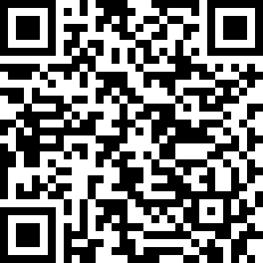
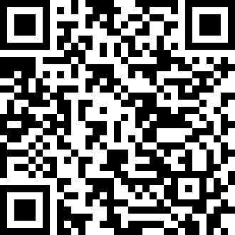
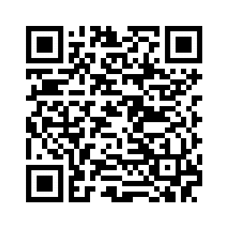
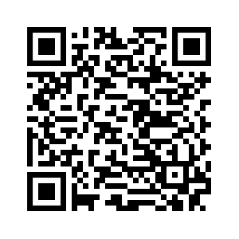

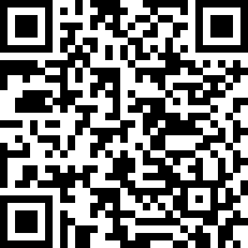
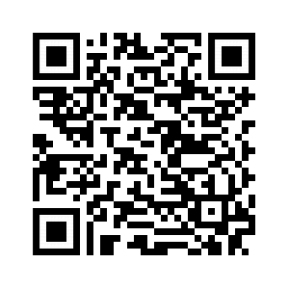
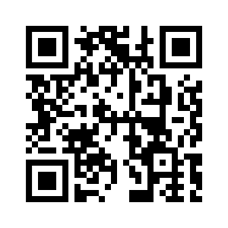

Readings on FinTech
Digital Finance Platforms
www.ssrn.com/abstract=3532975
FT4FI Roadmap
www.ssrn.com/abstract=3245287
Future of Data-Driven Finance
www.ssrn.com/abstract=3359399
AI in Finance: Putting Humans ….
www.ssrn.com/abstract=3531711
TechFin / Data-driven Finance
www.ssrn.com/abstract=2959925
Corporate Technologies (AI etc.) www.ssrn.com/abstract=3392321
Rise of Tech Risk
www.ssrn.com/abstract=3478640
Distributed Ledgers / Blockchain
www.ssrn.com/abstract=3018214
Regulatory Sandboxes
www.ssrn.com/abstract=3018534
Regulating Libra
www.ssrn.com/abstract =3414401
ICO Gold Rush www.ssrn.com/abstract=3072298
eID / KYC Utilities
www.ssrn.com/abstract=3224115

